Slide 1
YAKIN DOĞU ÜNİVERSİTESİ TIP FAKÜLTESİ
DEKAN- ÖĞRENCİ BULUŞMASI
DEAN-STUDENTS MEETING
18.05.2026

Slide 2
İLETİŞİM İÇİN (FOR COMMUNICATION)
medicine@neu.edu.tr
Dekanlık mail adresidir( e-mail address of the Dean’s Office)
Öğrenciler istek/ geribildirim/şikayetlerini bu adrese yazar (students send email to request/ feedback/petitions to this address).
Öğrenciye 3 gün içinde cevap verilir ( students receive reply no later than 3 days).
Hatırlatma en az 3 gün sonra yapılmalıdır ( no reminder before 3 days.

Slide 3
WEBSİTESİ ( WEBSITE)
https://medicine.neu.edu.tr/
Öğrenciler web sitesindeki bilgileri inceler (Students read all the information on the website).
Examples:
Program kataloğu (Course catalogue)
Öğrenci el kitabı (Student handbook)
Program kataloğu (Program catalogue)
Komisyon/kurulların bilgisi (Adresses of the commissions)
Koordinatörlerin iletişim adresleri (info about Who is who and their adressess)
Akademik takvim ( academic calender)

Slide 4
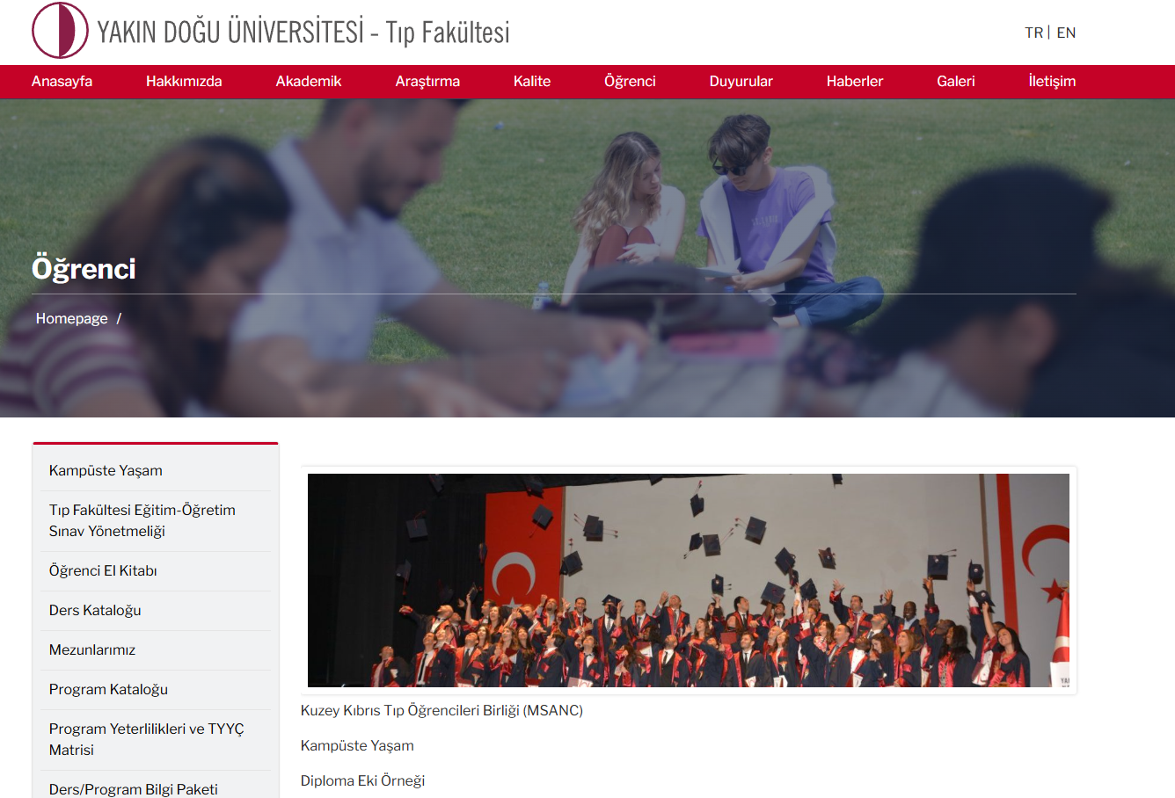

Slide 5


Slide 6
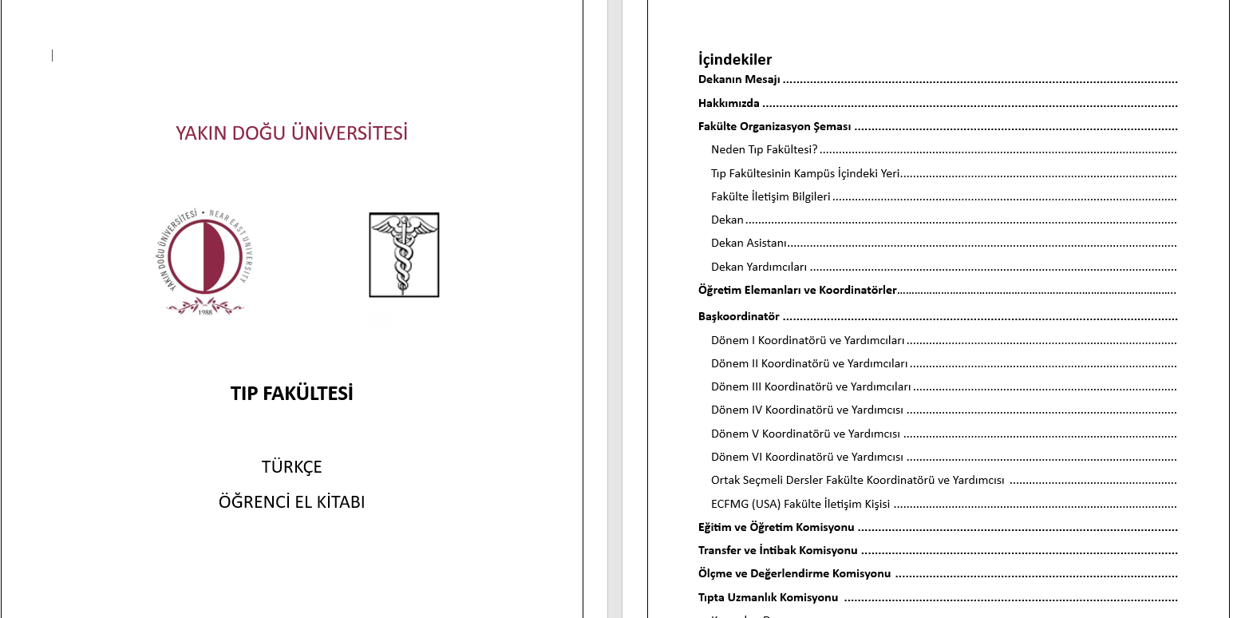
https://medicine.neu.edu.tr/ogrenci/ogrenci-el-kitabi/

Slide 7
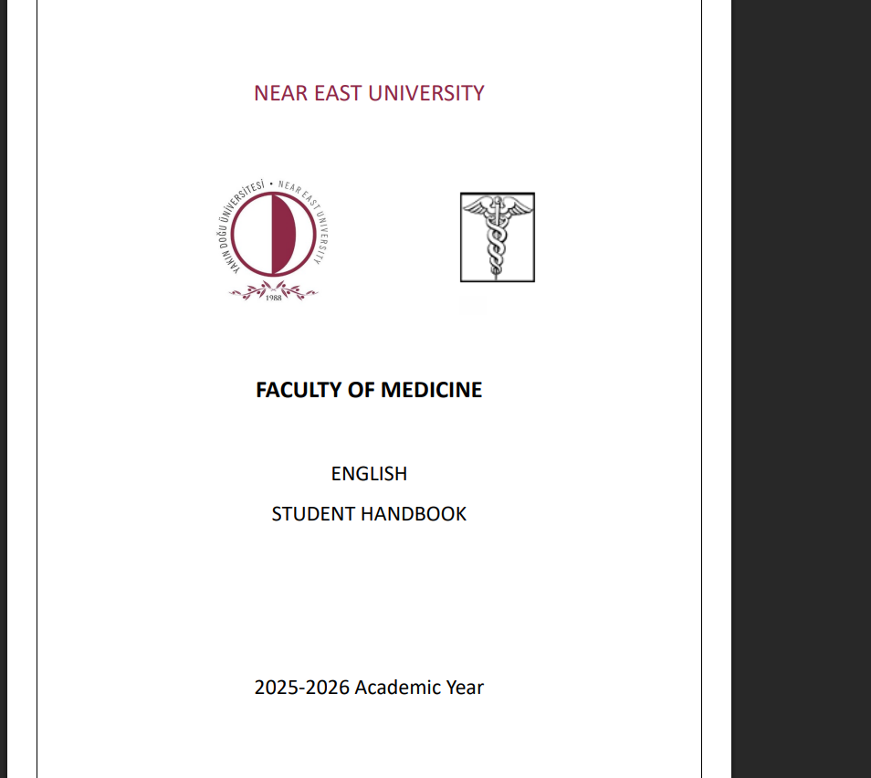
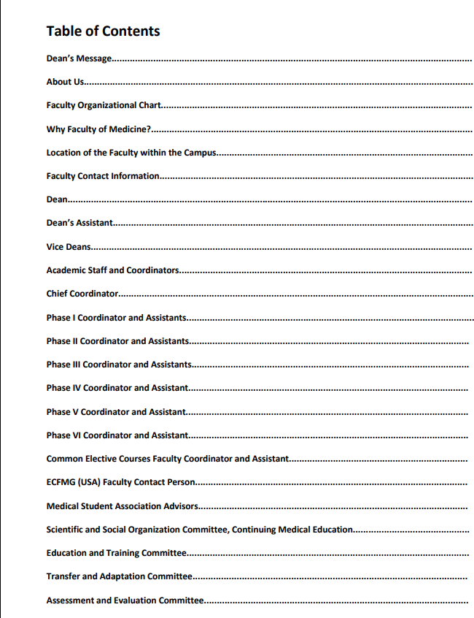
STUDENT HANDBOOK https://medicine.neu.edu.tr/wp-content/uploads/sites/137/2025/11/19/YDU-Tip-Fakultesi-2025-2026-Student-Handbook-bd.pdf?ver=87f032c77e210fca98e8f2bc6522c422

Slide 8
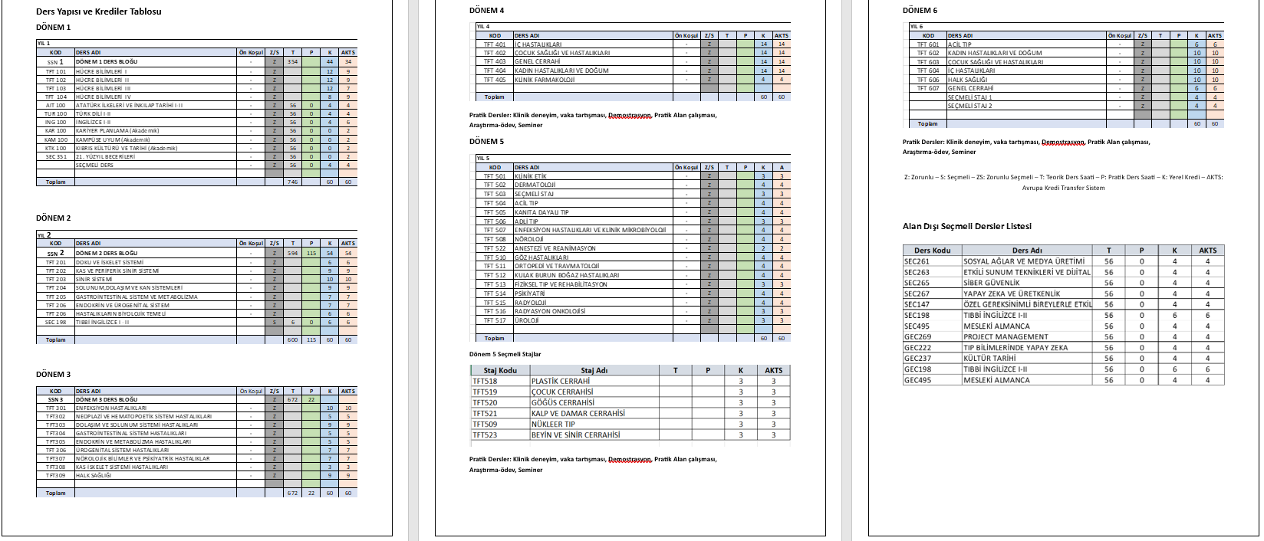

Slide 10
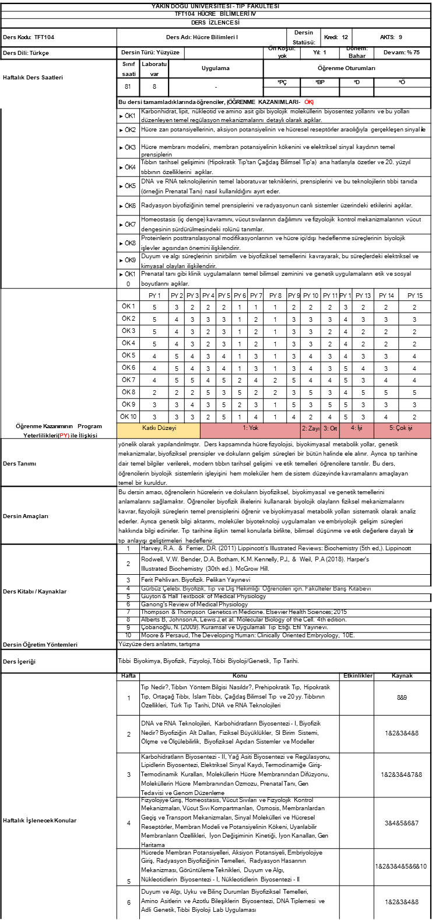
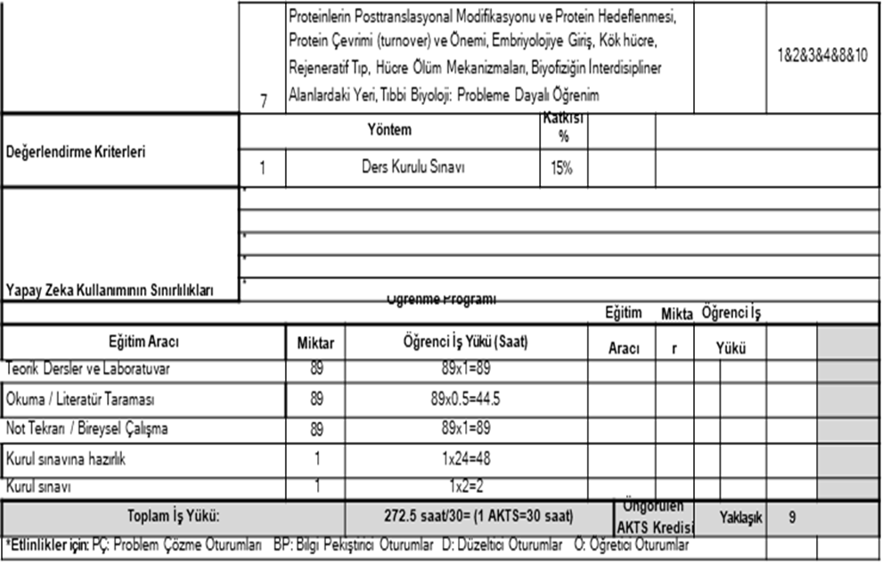

Slide 12
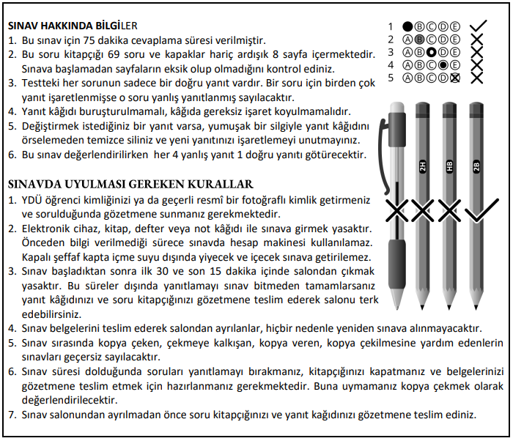
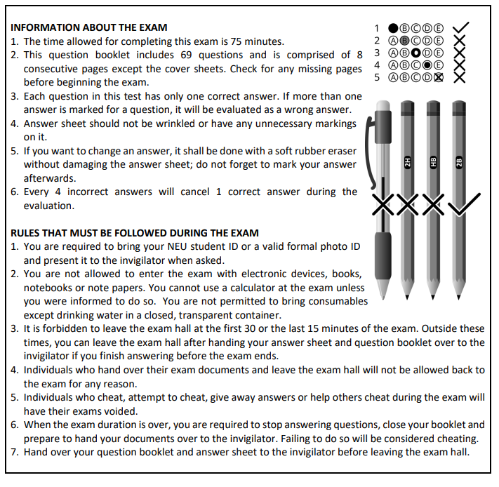

Slide 14
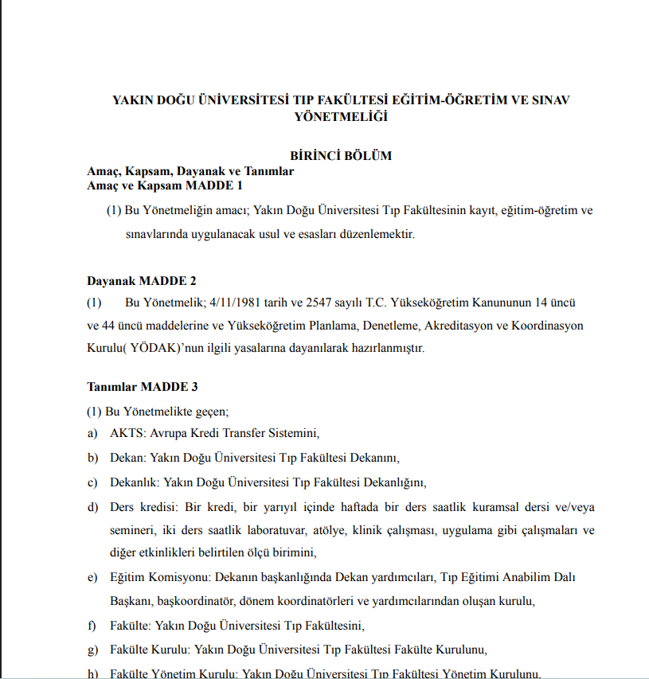
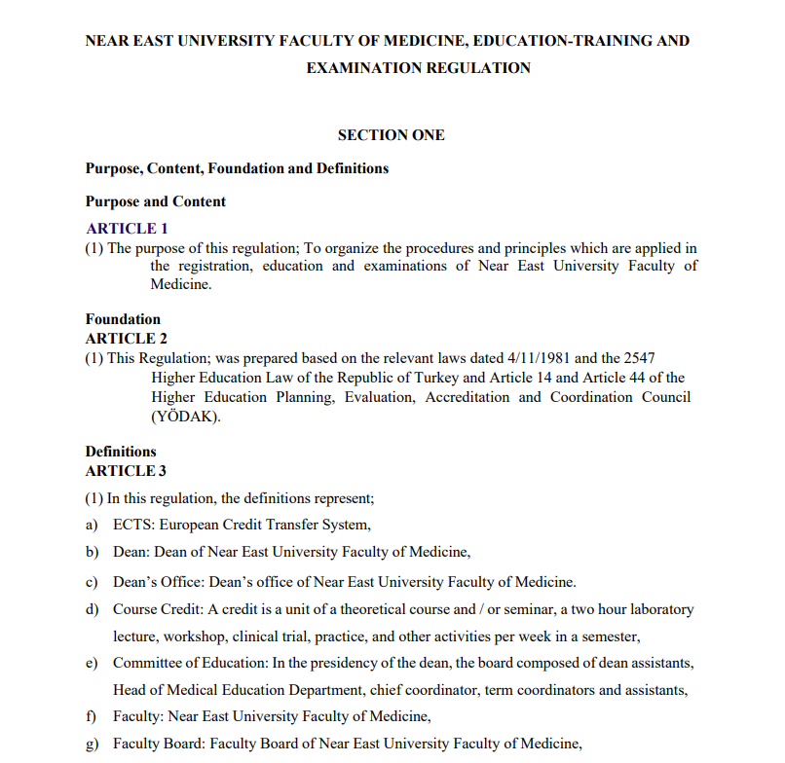
https://medicine.neu.edu.tr/wp-content/uploads/sites/137/2023/11/24/YDU-TIP-Yonetmelik-ENG_23.Eylul_.2021.pdf?ver=5efa0b115a8a873896a73ee250db5030
https://medicine.neu.edu.tr/ogrenci/

Slide 15
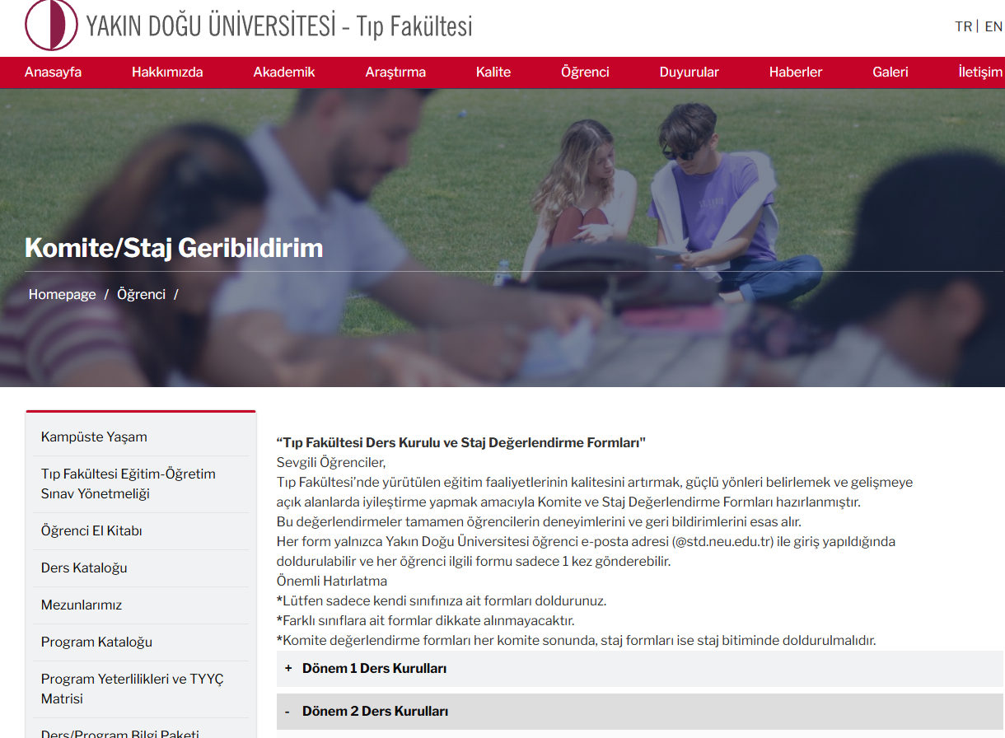
GERİBİLDİRİM FORMLARI :https://medicine.neu.edu.tr/ogrenci/komite-staj-geribildirim/

Slide 16
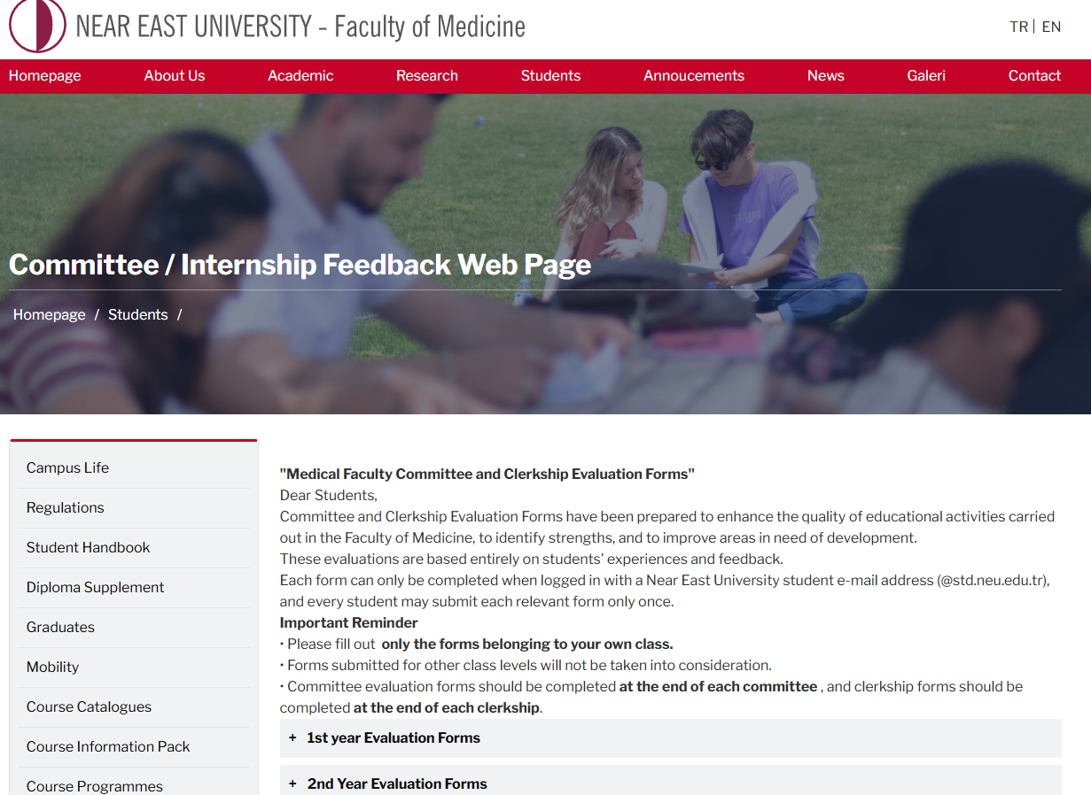
FEEDBACK FORMS: https://medicine.neu.edu.tr/students/committee-internship-feedback-web-page/?lang=en

